Slide 1
One-dimensional random walk with unit steps
11th grade student of Kyiv Natural Science Lyceum No. 145
Yehor Kozyr
Supervisor: Dorogovtsev Andriy
Head of the Department of the Theory of Random Processes Institute of Mathematics of the National Academy of Sciences of Ukraine, doctor of science, professor

Slide 2
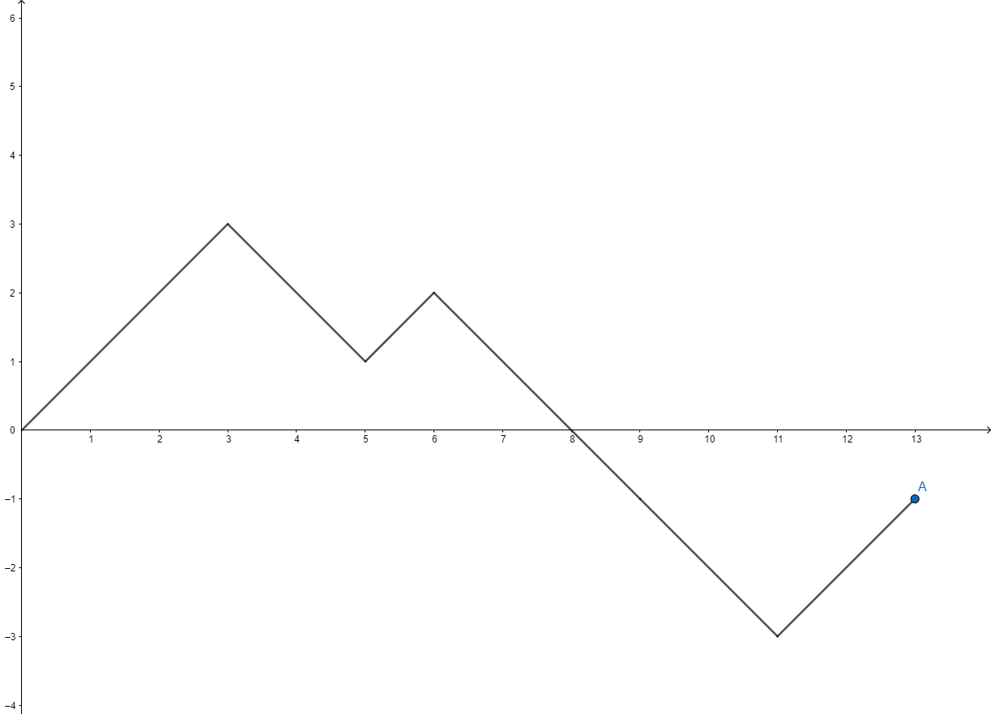
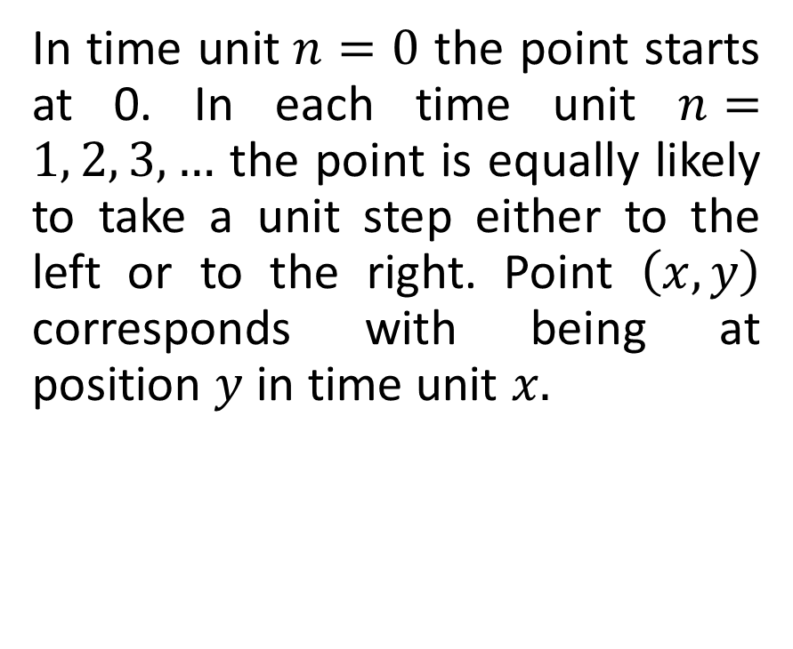
One-dimensional random walk with unit steps
In time unit$n=0$ the point starts at 0. In each time unit $n=1, 2, 3,…$ the point is equally likely to take a unit step either to the left or to the right. Point $\left(x,y\right)$ corresponds with being at position $y$ in time unit $x.$
3

Slide 3
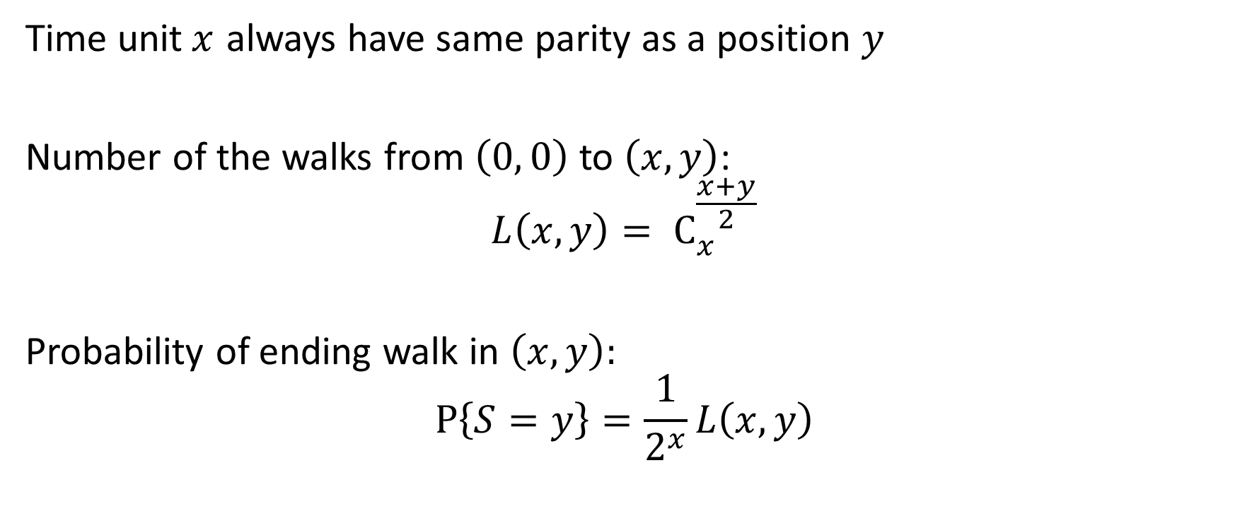
Properties
Time unit$x$ always have same parity as a position $y$
Number of the walks from $\left(0, 0\right)$ to $\left(x, y\right)$:
$$L\left(x,y\right){= С}_{x}^{\frac{x+y}{2}}$$
Probability of ending walk in $\left(x,y\right)$:
$$P\left\{S=y\right\}=\frac{1}{2^{x}}L\left(x,y\right)$$
4

Slide 4
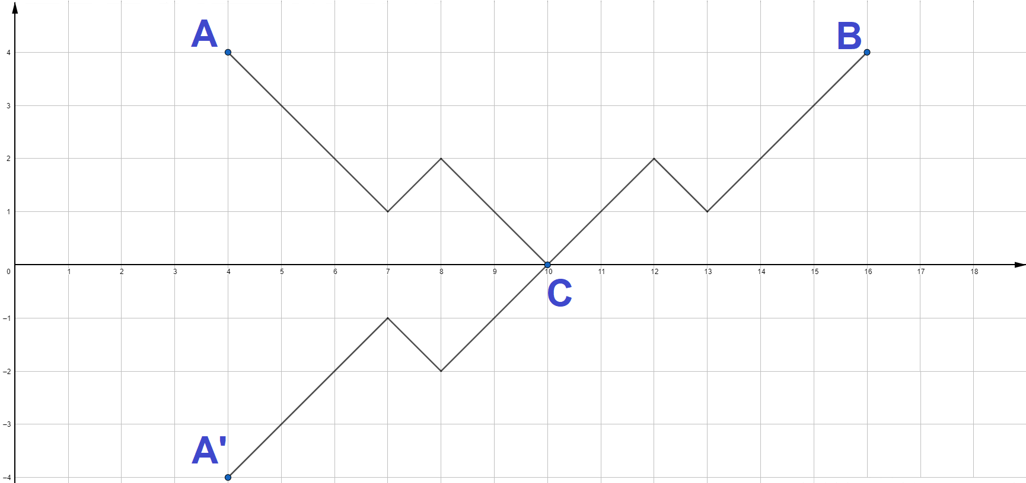

Reflection principle
Let $A$ and $B$ – dots with integer coordinates $\left(x_{0},y_{0}\right)$ and $\left(x,y\right)$
Then number of walks from $A$ to $B$, that touch or intersect abscissa axis equal to number of walks from $A^{′}$ to $B,$ where $A^{′}$ is a reflection of $A.$
5

Slide 5
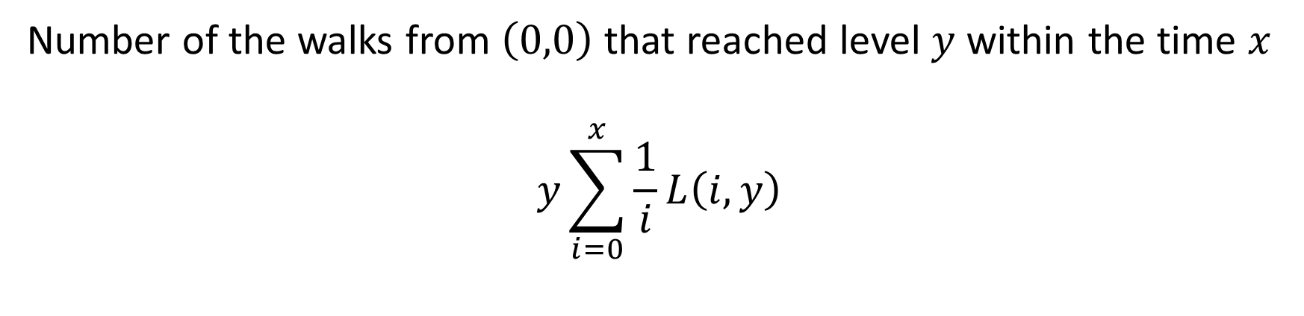
Theorem about reaching certain level
Number of the walks from $\left(0,0\right)$ that reached level $y$ within the time $x$
$$y\sum_{i=0}^{x}{\frac{1}{i}L\left(i,y\right)}$$
7

Slide 6
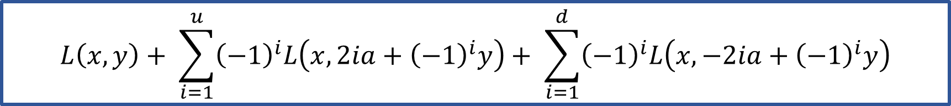

Theorem about walking in barriers
Number of the walks from $\left(0, 0\right)$ to $\left(x, y\right)$, that do not reach barriers $a$ and $−a$
$u, d−$number of intermediate reflections, which uniquely determined by the values of $x$,$y$ and $a$.
$$L\left(x,y\right)+ \sum_{i=1}^{u}{{\left(−1\right)}^{i}L\left(x,2ia+{\left(−1\right)}^{i}y\right)}+ \sum_{i=1}^{d}{{\left(−1\right)}^{i}L\left(x,−2ia+{\left(−1\right)}^{i}y\right)}$$
8

